Slide 1
ECE314 Lab 3 Overview
Random process
Bernoulli process
Poisson distribution vs. Binomial distribution

Slide 2

Random process
Random variable
$$X_{1}$$
$$X_{2} X_{3} X_{4} X_{5} X_{6} X_{7} X_{8} X_{9} X_{10} ⋯$$
Random process

Slide 3
Bernoulli process
Independent Bernoulli(p) random variables
$$X_{1} X_{2} X_{3} X_{4} X_{5} X_{6} X_{7} X_{8} X_{9} X_{10} ⋯$$

Slide 4
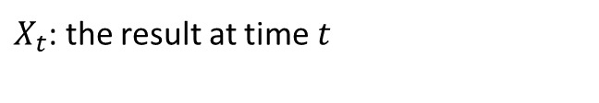
Bernoulli process: four ways of description
$$t 1 2 3 4 5 6 7 8 9 10$$
$X_{t}$: the result at time $t$
$$X 0 1 0 1 0 0 1 1 1 0$$

Slide 5


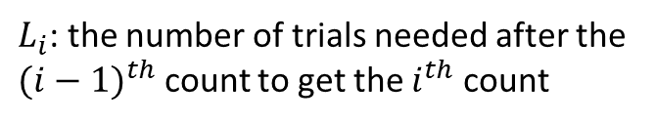




Bernoulli process: four ways of description
$$t 1 2 3 4 5 6 7 8 9 10$$
$X_{t}$: the result at time $t$
$$X 0 1 0 1 0 0 1 1 1 0$$
$L_{i}$: the number of trials needed after the ${(i−1)}^{th}$ count to get the $i^{th}$ count
$$L$$
$$2$$
$$2$$
$$3$$
$$1$$
$$1$$

Slide 6







Bernoulli process: four ways of description
$$t 1 2 3 4 5 6 7 8 9 10$$
$X_{t}$: the result at time $t$
$$X 0 1 0 1 0 0 1 1 1 0$$
$L_{i}$: the number of trials needed after the ${(i−1)}^{th}$ count to get the $i^{th}$ count
$$L$$
$$2$$
$$2$$
$$3$$
$$1$$
$$1$$
$S_{i}$: the time the $i^{th}$ count occurs
$$S$$
$$2$$
$$4$$
$$7$$
$$8$$
$$9$$

Slide 7



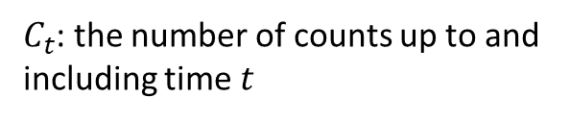








Bernoulli process: four ways of description
$$t 1 2 3 4 5 6 7 8 9 10$$
$X_{t}$: the result at time $t$
$$X 0 1 0 1 0 0 1 1 1 0$$
$L_{i}$: the number of trials needed after the ${(i−1)}^{th}$ count to get the $i^{th}$ count
$$L$$
$$2$$
$$2$$
$$3$$
$$1$$
$$1$$
$S_{i}$: the time the $i^{th}$ count occurs
$$S$$
$$2$$
$$4$$
$$7$$
$$8$$
$$9$$
$$4$$
$$5$$
$C_{t}$: the number of counts up to and including time $t$
$$C$$
$$0$$
$$1$$
$$1$$
$$2$$
$$2$$
$$2$$
$$3$$
$$5$$

Slide 8
Bernoulli process: four ways of description
$$t 1 2 3 4 5 6 7 8 9 10$$
$X_{t}$: the result at time $t$
$$X 0 1 0 1 0 0 1 1 1 0$$
$L_{i}$: the number of trials needed after the ${(i−1)}^{th}$ count to get the $i^{th}$ count
$$L$$
$$2$$
$$2$$
$$3$$
$$1$$
$$1$$
$S_{i}$: the time the $i^{th}$ count occurs
$$S$$
$$2$$
$$4$$
$$7$$
$$8$$
$$9$$
$$4$$
$$5$$
$C_{t}$: the number of counts up to and including time $t$
$$C$$
$$0$$
$$1$$
$$1$$
$$2$$
$$2$$
$$2$$
$$3$$
$$5$$
The four different descriptions are equivalent: knowing one gives you the other three.
Covered in Section 2.6 of ECE313 notes

Slide 9



Poisson distribution vs. Binomial distribution
$$X∼Poisson(λ)$$
$$Y∼Binomial(n,p)$$
$$pmf: \operatorname{Pr}\left(X=k\right)=\frac{λ^{k}}{k!}e^{−λ}, k≥0$$
$$pmf: \operatorname{Pr}\left(Y=k\right)= \left({n \atop k}\right)p^{k}{\left(1−p\right)}^{n−k}, 0≤k≤n$$

Slide 10
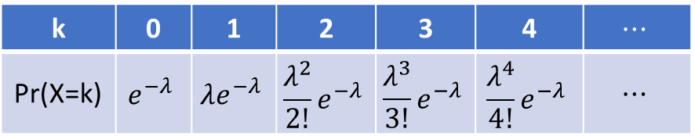
Poisson distribution vs. Binomial distribution
$$X∼Poisson(λ)$$
$$Y∼Binomial(n,p)$$
$$pmf: \operatorname{Pr}\left(X=k\right)=\frac{λ^{k}}{k!}e^{−λ}, k≥0$$
$$pmf: \operatorname{Pr}\left(Y=k\right)= \left({n \atop k}\right)p^{k}{\left(1−p\right)}^{n−k}, 0≤k≤n$$
k | 0 | 1 | 2 | 3 | 4 | $$⋯$$
Pr(X=k) | $$e^{−λ}$$ | $$λe^{−λ}$$ | $$\frac{λ^{2}}{2!}e^{−λ}$$ | $$\frac{λ^{3}}{3!}e^{−λ}$$ | $$\frac{λ^{4}}{4!}e^{−λ}$$ | $$⋯$$

Slide 11
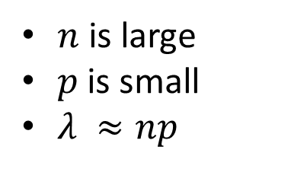

Poisson distribution vs. Binomial distribution
$$≈$$
$$X∼Poisson(λ)$$
$$Y∼Binomial(n,p)$$
$$pmf: \operatorname{Pr}\left(X=k\right)=\frac{λ^{k}}{k!}e^{−λ}, k≥0$$
$$pmf: \operatorname{Pr}\left(Y=k\right)= \left({n \atop k}\right)p^{k}{\left(1−p\right)}^{n−k}, 0≤k≤n$$
$n$ is large
$p$ is small
$λ ≈np$
See Section 2.7 of ECE313 notes for a proof
Example: You are given a distribution $Y∼Bernoulli(2000, 0.001)$. You want to find $P(Y=3)$.
Let $λ=2000 ∗0.001=2$ and let $X∼Poisson(2)$. Then $P\left(Y=3\right)≈P\left(X=3\right)= \frac{2^{3}}{3!}e^{−2}=\frac{4}{3}e^{−2}.$

